Slide 1
Rockbuster Stealth LLC Movie Rental Company
Data Analytics Team

Slide 2
Project Overview
Rockbuster Stealth LLC is a movie rental company which has stores around the world and presently is facing stiff competition from streaming services such as Netflix and Amazon Prime.
Rockbuster Stealth management team is planning to use its existing movie licenses to launch an online video rental service in order to stay competitive.
Key questions
Which movies contributed the most/least to revenue gain?
Which countries are Rockbuster customers based in?
Do sales figures vary between geographic regions?

Slide 3
Rockbuster Profile At a glance
1000 movies
600 cities
599 customers
109 countries
22 genres
2 stores

Slide 4
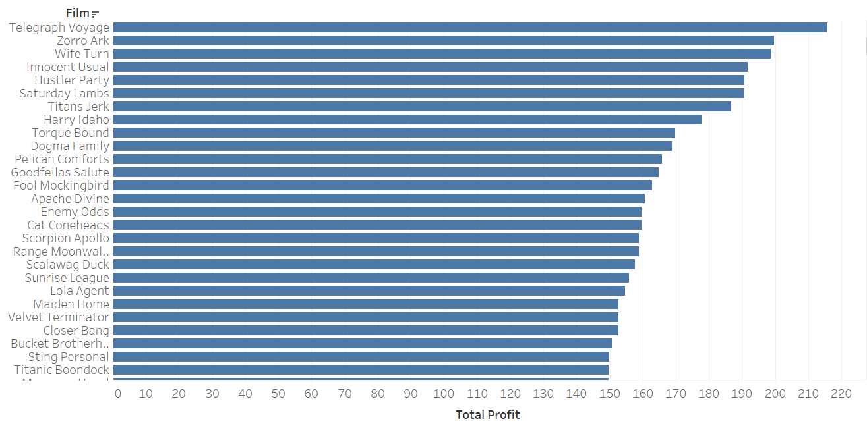
Revenue by film

Slide 5
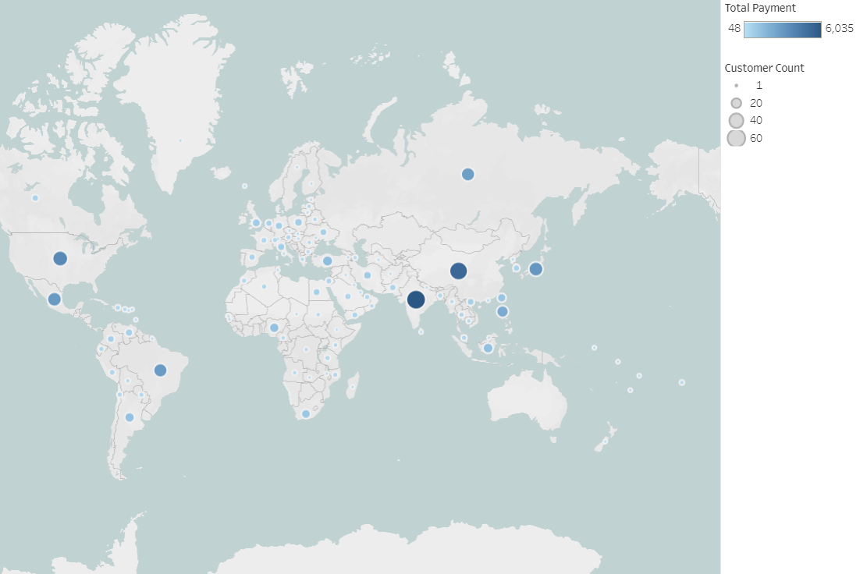
Revenue by country

Slide 6
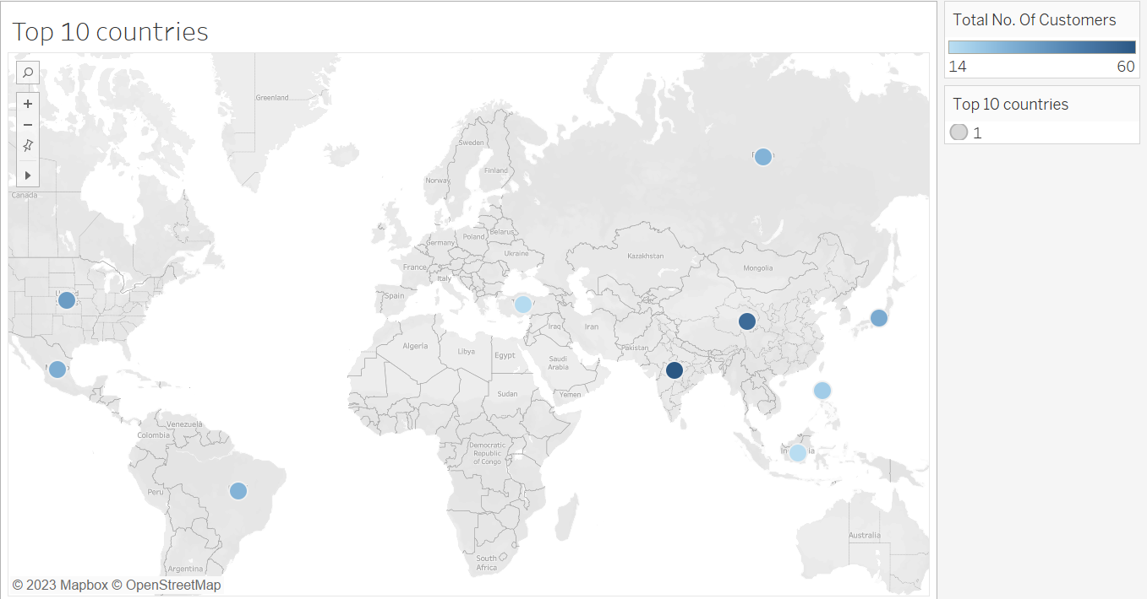
Top 10 countries

Slide 7
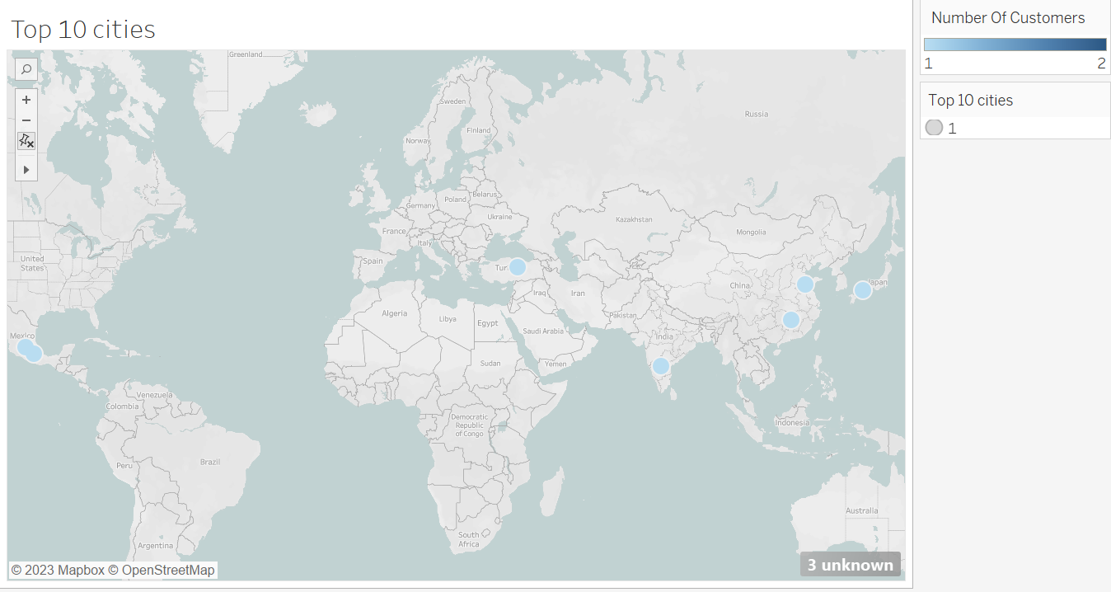
Top 10 cities

Slide 8
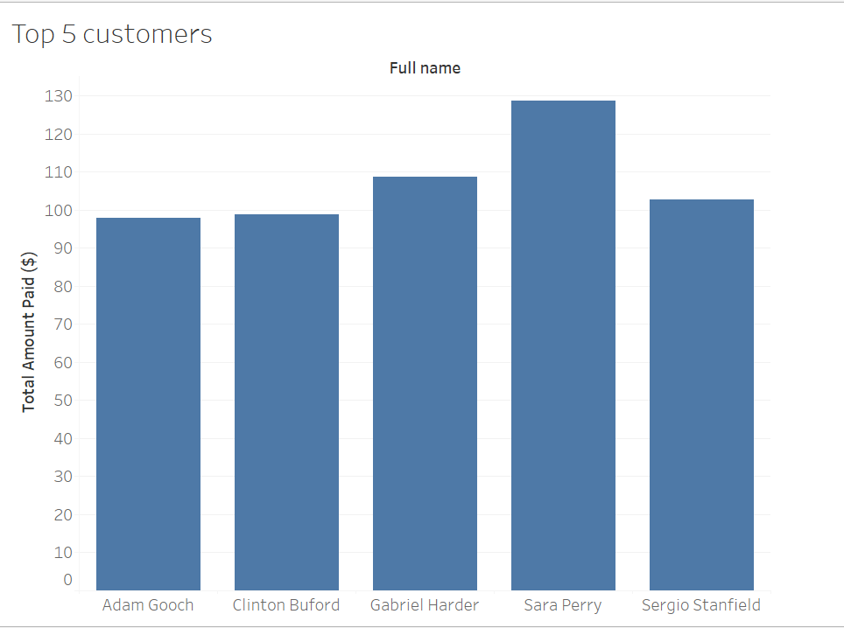
Top 5 customers

Slide 9
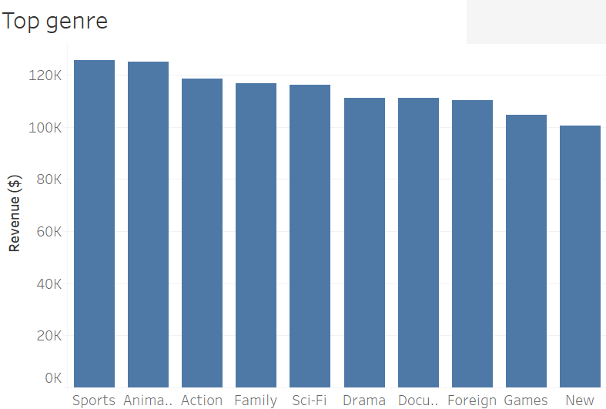
TOP GeNRE

Slide 10
Recommendations
The company can target the top 3 revenue making countries which are India, China, and the United States.
The marketing team can do more promotion in the cities which have highest number of customers such as Celaya, atlixco, sivas, adoni, etc.
The marketing team can focus more promotions within top 3 popular genre with highest number of revenue which are sports, animation and action.
The company can add more movies belonging to the top 3 popular genres.
The url for tableau dashboard is https://public.tableau.com/app/profile/ketki1755/viz/Ketki_task_3_10/Story1?publish=yes

Slide 11
THANK YOU

